Slide 1
Information and Application of Embedded Processor and IoT
ESP32
Lucy Cui

Slide 2
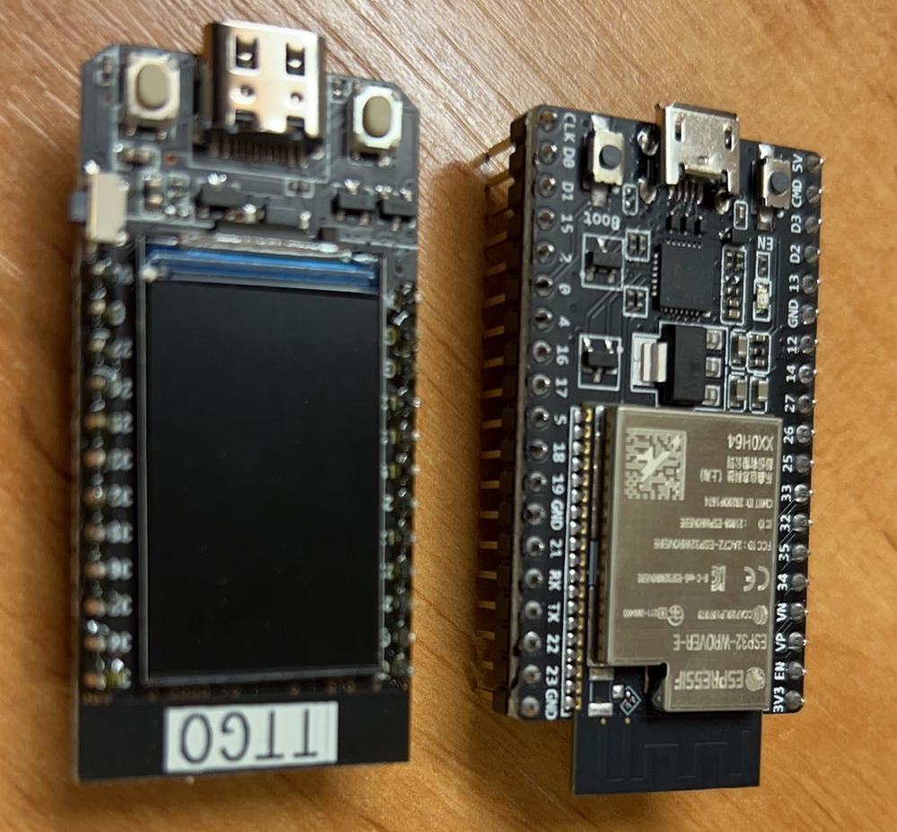
Embedded processor
Perform operations on a data sourse
Memory, I/O devices
Embedded system
Controls physical operations of the bigger machine
ESP32:
Microcontroller with integrated Wi-Fi
Connect to the Internet
Connect to other devices, exchange information

Slide 3
Internet of Things (IoT)
Physical objects connect and exchange data with other devices
Via network
Evolved due to technology development
Embedded systems and machine learning

Slide 4
Market by application /geography/platform
Smart retail
Smart energy
Transportation
...
Huge increase in market size in 5 years

Slide 5
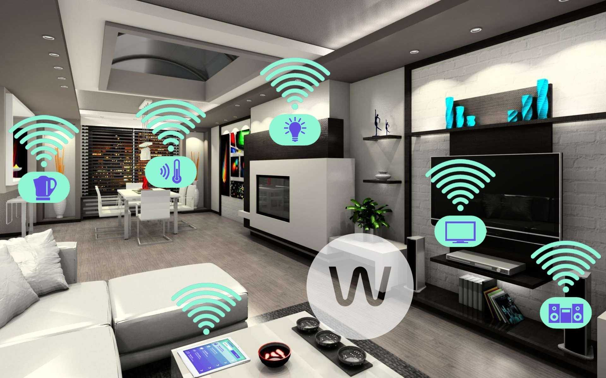
Differences made by IoT
Healthcare: telemedicine
Smart home: furniture
Smart varehouse: allocation
Traffic control: efficiency

Slide 6
Major challenges
Security and privacy
Unified technical standards
Data processing
Update technology

Slide 7
Ethical concerns
Attack risks
Privacy misuse
Law & regulation
Trust

Slide 8
Applications

Slide 9
Reference
https://en.wikipedia.org/wiki/Embedded_system
https://en.wikipedia.org/wiki/ESP32
https://en.wikipedia.org/wiki/Internet_of_things
https://baijiahao.baidu.com/s?id=1741941827317174056&wfr=spider&for=pc
https://www.sohu.com/a/547844453_120700738
https://www.verifiedmarketresearch.com/product/global-internet-of-things-iot-market-size-and-forecast-to-2026/#:~:text=Internet%20of%20Things%20%28IoT%29%20Market%20By%20Applications%201,Retail%206%20Smart%20mobility%207%20transportation%208%20Others
https://ieeexplore.ieee.org/abstract/document/8390757
https://www.bing.com/images/search?view=detailV2&ccid=1OOZEnWR&id=3C81E1A170C5908123179ECCA84104CF81B0E168&thid=OIP.1OOZEnWRSeEesUJc2xfF3AHaEo&mediaurl=https%3a%2f%2fwww.architectureartdesigns.com%2fwp-content%2fuploads%2f2017%2f07%2fAAEAAQAAAAAAAAm5AAAAJGIyMDk5NmYyLTQyNDItNGYxZi05MTE3LWM3M2M1MTU5NDFjZg.jpg&cdnurl=https%3a%2f%2fth.bing.com%2fth%2fid%2fR.d4e39912759149e11eb1425cdb17c5dc%3frik%3daOGwgc8EQajMng%26pid%3dImgRaw%26r%3d0&exph=1200&expw=1920&q=smart+home&simid=608021194697872194&FORM=IRPRST&ck=E600923CC342F27E673E9E9CE08400AC&selectedIndex=10&ajaxhist=0&ajaxserp=0

Slide 10
Thank you!
Contact: zcabhcu@ucl.ac.uk

